Slide 1
COVID-19 Prevention
Aggie Public Health Ambassador Program
Notes:
Hello there! My name is [APHA Name], and I am an Aggie Public Health Ambassador from UC Davis.
Aggie Public Health Ambassadors are UC Davis college students who teach people in Davis about how to stop the spread of COVID-19 and keep our community safe.

Slide 2
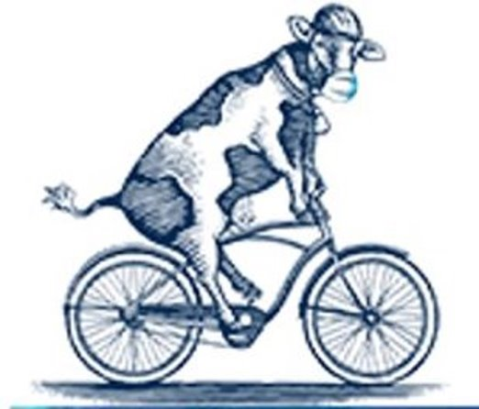
Lesson Overview:
COVID-19 Prevention
What is COVID-19?
How Does it Spread?
Who Can Get COVID-19?
What You Can Do to Stop the Spread?
Notes:
Today we will be learning what COVID-19 is, how it spreads, and who can get it.
We will also talk about the ways that you can help stop the spread of COVID-19 to keep yourself, your family, your friends, and your community safe.

Slide 3
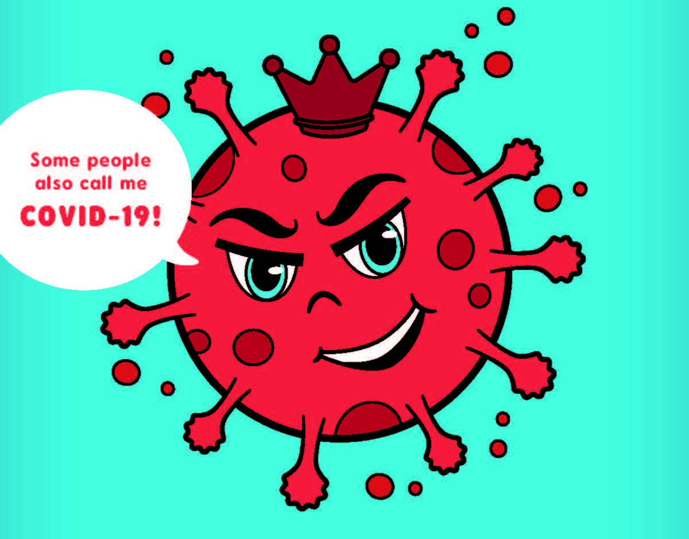
What is COVID-19?
Coronavirus is a virus that causes the disease called COVID-19.
Corona is Latin for "crown”.
A lot of the symptoms are similar to the flu, like a dry, itchy, cough, and a fever, but the coronavirus is more contagious and deadly than the flu.
This virus has made many people very sick.
Notes:
Coronavirus is a virus that causes the disease called COVID-19.
A virus is basically a tiny germ that you can't see with your eyes, and can make you sick.
Scientists call this kind of virus the coronavirus, because Corona means crown in Latin, and under a microscope, these viruses look like a crown with spikes.
When you're sick, you usually have symptoms, which are body changes like a fever that let you know something's not right. Some people may get COVID-19, but never have any symptoms. Other people can get very sick with symptoms like a fever or cough, or they may have a hard time breathing.
Some people are able to feel better quickly by resting and drinking lots of fluids in their own homes. This doesn’t mean that the virus is immediately gone from their body, so they still need to be careful to stay home and away from other people for a total of 2 weeks.
While some people can recover at home, in the United States and throughout the world this virus has made many people very sick. Many people have had to go to the hospital because they need doctors to give them medicine, tests and sometimes help from machines to help them breathe.

Slide 4
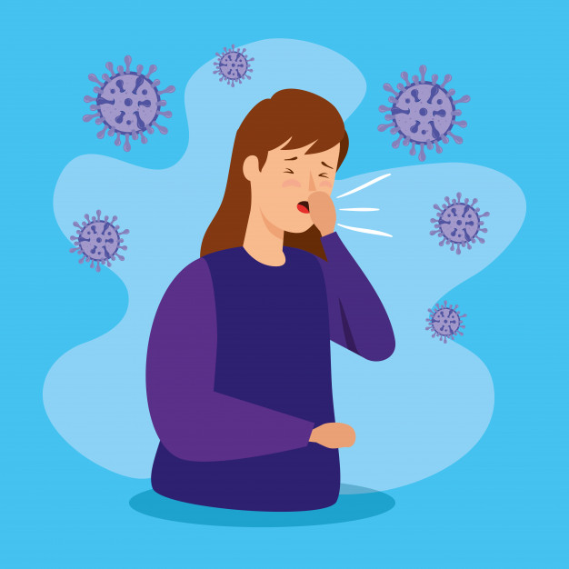
How Does COVID-19 Spread?
COVID-19 spreads very easily.
The virus is passed by sneezes, coughs, runny noses and saliva.
COVID most commonly spreads during close contact.
Notes:
COVID-19 spreads very easily from person to person through what are called respiratory droplets, which are drops of fluid from your lungs. Respiratory droplets fly into the air when you cough, sneeze, talk, shout, or sing.
Most of the time, COVID-19 is spread through close contact, which is when someone who does not have COVID-19 is around someone who does have it. Close contact means touching, hugging, or just sitting or standing closer than 6 feet to someone for 15 minutes or more.
COVID-19 is very contagious, which means that it is very easy for one person to get COVID-19 from another person. In fact, it is more contagious than the flu!
Respiratory droplets can also land on surfaces and objects. It is possible that a person could get COVID-19 by touching a surface or object that has the virus on it, like a table or a toy, and then touching their own mouth, nose, or eyes.
However, COVID-19 is spread most commonly by close contact with someone who has COVID-19.

Slide 5
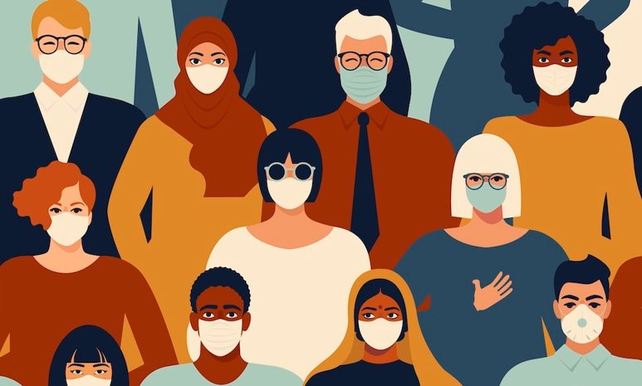
Who Can Get COVID-19?
This kind of virus can affect anybody.
Just because someone looks different or talks different doesn't mean they are more likely to have COVID-19.
Older people or people with health problems are more likely to get very sick or die if they get COVID-19.
Notes:
Anybody can get COVID-19. However, it can affect everyone differently.
Although not many kids get COVID-19, young and healthy people can still get very sick or die from the virus.
Some people get mild symptoms, which means you may feel sick with something similar to the flu, but you'll be able to get over it with some rest at home.
However, other people, especially those who are much older or who already have health problems are more likely to get very sick or die if they get COVID-19.

Slide 6
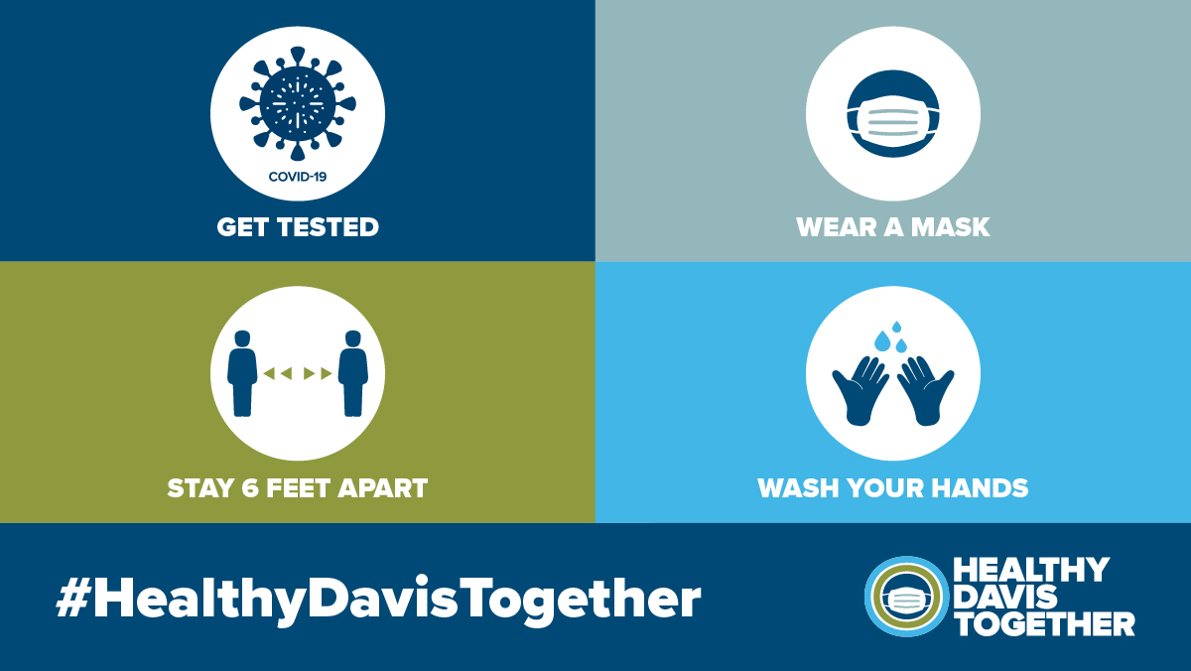
How Can You Help Stop the Spread?
Wearing a Mask
Physical Distancing
Hand Washing
Testing
Stay home if you're sick
Notes:
There are many ways you can help stop the spread of COVID-19 to protect yourself and other people.
The most important things you can do are: Wear a face covering , distance yourself from others, wash your hands often , get tested for COVID-19 regularly , and stay home if you're sick .

Slide 7
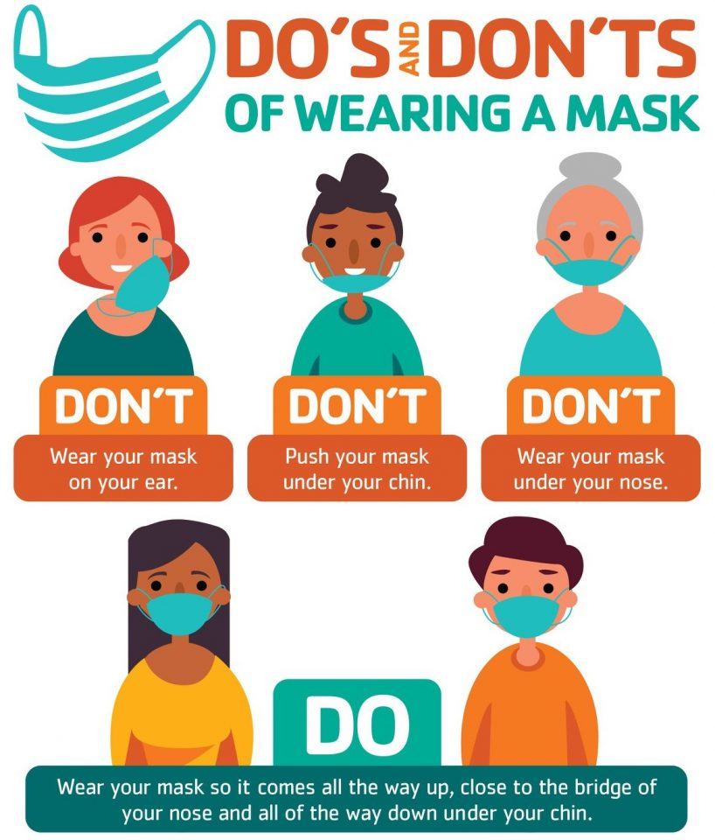
Cover Your Face
Wear a mask:
Inside: anytime you are indoors with someone who doesn't live with you; exceptions are eating or drinking.
Outside: when you cannot stay 6 feet away from others.
Masks protect us the best when everyone wears one!
Notes:
Wearing a mask is a simple way to help prevent your respiratory droplets from reaching others.
You should wear a mask, even if you do not feel sick. This is because people with COVID-19 who never have symptoms and those who do not yet have symptoms can still spread the virus to other people.
Wearing a mask helps protect those around you, in case you have gotten COVID-19 but are not feeling sick.
It is very important to wear a mask when you are inside with people you do not live with. This is because if you are not wearing a mask around someone with COVID-19, you could get COVID-19 and then bring it back to your house and make your family sick.
It’s also very important to wear a mask outdoors when you are unable to stay at least 6 feet apart from others, since COVID-19 spreads mainly among people who are in close contact with one another.
Make sure that you are wearing your mask correctly – this means it needs to cover your nose, mouth, and chin.
Make sure your face covering fits snugly, but it's not so tight that you can't breathe. You also want to make sure it's not too loose, which would allow your respiratory droplets to escape. Your mask is too loose if the material does not touch your face on the top, bottom, and on both sides.
Masks can protect us the best when all of us wear one!

Slide 8
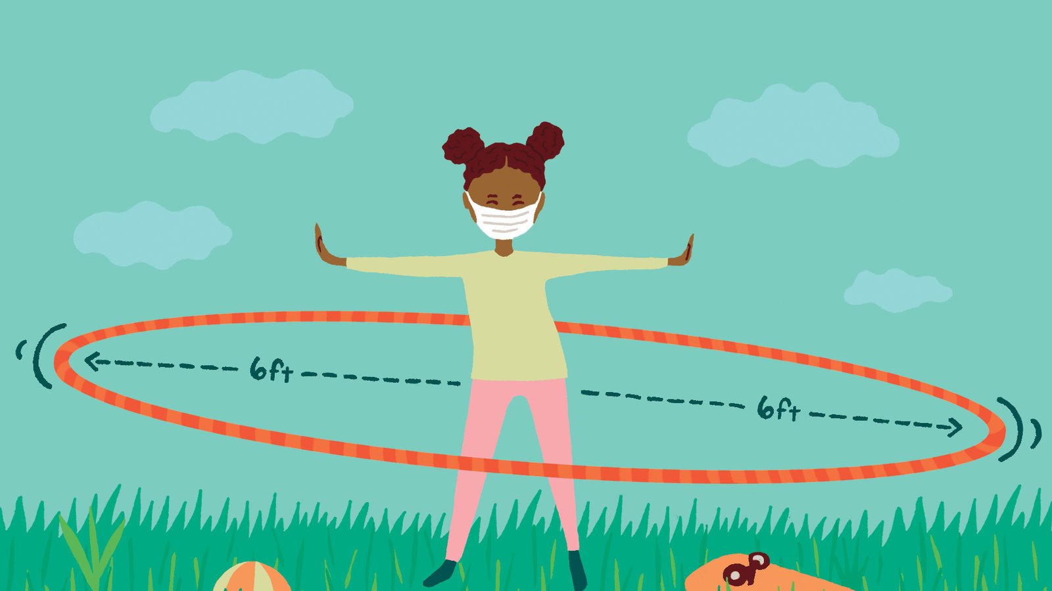
Keep Your Distance
Physical distancing means keeping space between yourself and people you do not live with. To practice physical distancing:
Stay at least 6 feet (about 2 arms’ length) from other people.
Do not gather in groups.
Stay out of crowded places and avoid big gatherings.
Notes:
Limiting close contact with others is the best way to reduce the spread of COVID-19.
Since people can spread the virus before they know they are sick, it is important to physically distance yourself from others when possible, even if you—or they—do not feel sick.
While at school, this means sitting or standing at least 3 feet apart from your classmates and teachers while in your classroom, or 6 feet apart while outside the classroom during breaks or lunch.
To practice physical distancing: stay at least 6 feet from other people, do not hang out in groups, and stay out of crowded places and avoid big gatherings of people.
Physical distancing is especially important to protect elderly adults, like your grandparents, and people who are have health problems.

Slide 9
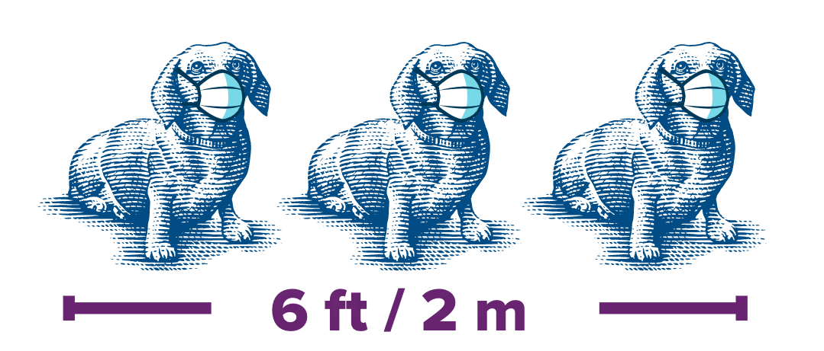
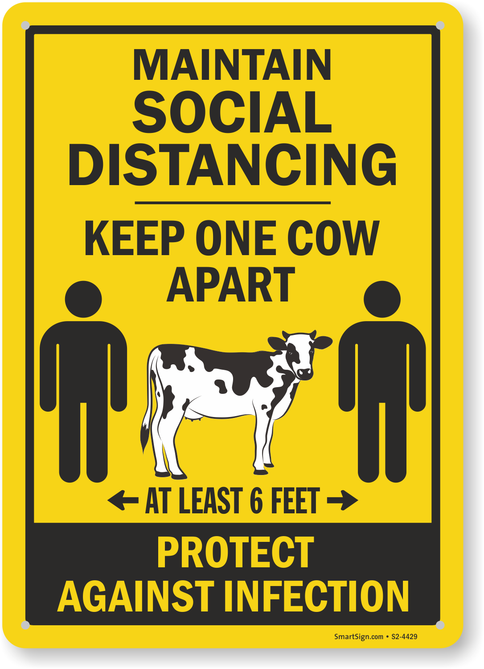
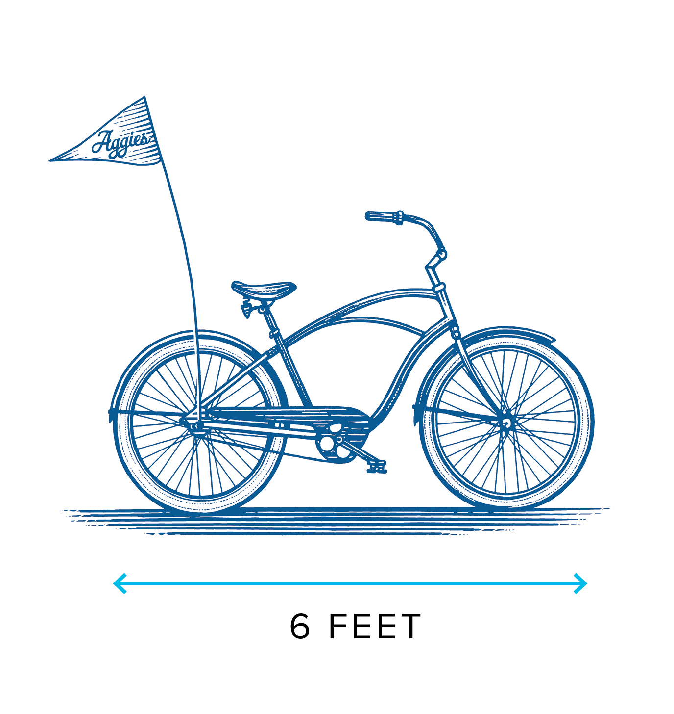
Notes:
There are many different ways to easily visualize what 6 feet looks like. This could include the length of 3 dachshund dogs, one bicycle, or, since we're in Davis - one cow.

Slide 10
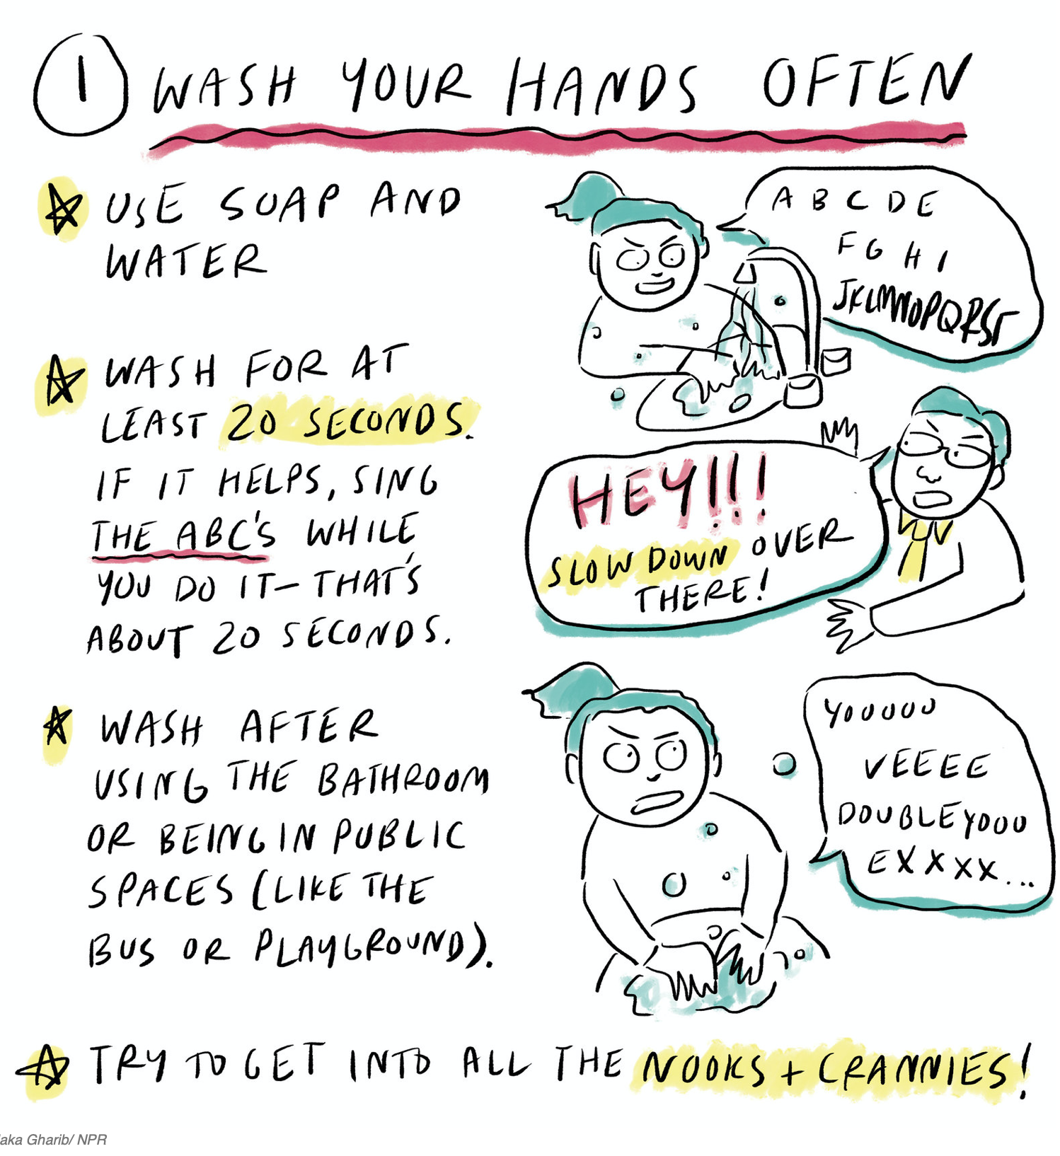
Wash Your Hands
Notes:
Washing your hands often can slow the spread of COVID-19.
Often means washing before and after eating a meal, after using the bathroom, sneezing, coughing or blowing your nose, and right after coming inside from playing outdoors, especially if you have been playing in a public park or at your school.
Wash your hands with soap and water for at least 20 seconds, which is about the time it takes to sing the ABC's or the Birthday Song twice.
If soap and water are not available, you can use hand sanitizer. Also, make sure if you have to sneeze or cough, you do it into your elbow and not your hands.

Slide 11
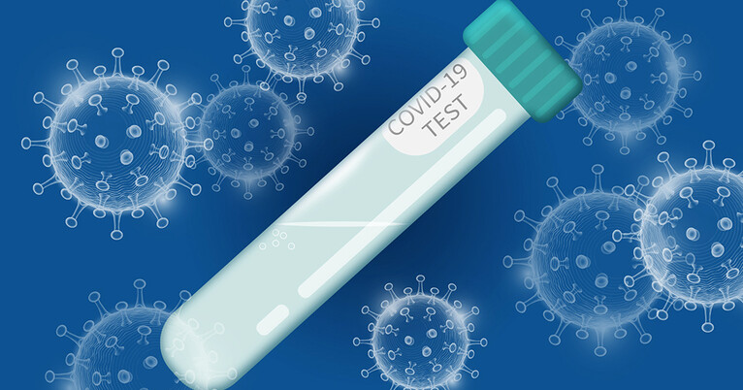
Get Tested
The saliva test in Davis is free, quick and painless.
Get tested once or twice a week!
Notes:
You and your family should get tested for COVID-19 once or twice a week even if you do not feel sick.
We are very lucky in Davis to have access to free and fast COVID-19 testing, which makes it easy for the Davis community to get tested often.
The test we do is a saliva test, so you just need to spit into a tube, which is then taken to a lab to examine. It's painless, quick and easy! You then find out if you do or do not have COVID-19 in 1-2 days.
UC Davis and the city of Davis work together to provide the testing, and you may have seen ads for it on TV and signs in Davis. You can get tested many different places, like the Senior Center, Mondavi Center, and Veterans Memorial Center.

Slide 12
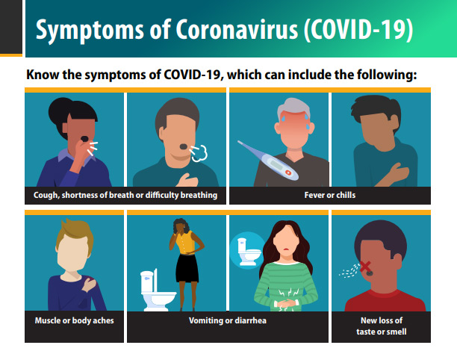
Monitor Your Symptoms
Some other potential COVID-19 symptoms:
Sore throat
Runny nose or sinus congestion
Headache
Unusual fatigue
Eye redness with or without discharge
Notes:
Every day, it is important to pay attention to whether you have any symptoms that could be from COVID-19. This means to look for a cough, runny nose, or a fever.
If you feel sick, let your family know. They can help you figure out what you should do, which will most likely be staying home and resting.

Slide 13
Review
Notes:
So remember, the most important thing you can do to keep yourself, your family, your friends, and your community safe is to wear a mask, stay more than 6 feet away from other people you don't live with, wash your hands often, get tested once or twice a week, and stay home if you feel sick.
We're all in this together, and everyone can help stop the spread of COVID-19. As you can see in the picture, the Swiss Cheese Model shows us that we are most safe when we follow the recommendations of masking, physical distancing, hand washing, and testing.
The more we follow these recommendations, the quicker we can get back to normal.

Slide 14
References
Centers for Disease Control and Prevention (CDC). COVID-19 and Your Health. Updated March 17, 2021. Access March 26, 2021. https://www.cdc.gov/coronavirus/2019-ncov/symptoms-testing/testing.html.
CDC. How COVID Spreads. Updated October 28, 2021. Accessed March 24, 2021. https://www.cdc.gov/coronavirus/2019-ncov/prevent-getting-sick/how-covid-spreads.html.
CDC. Symptoms of Coronavirus. Updated February 22, 2021. Accessed March 24, 2021. https://www.cdc.gov/coronavirus/2019-ncov/symptoms-testing/symptoms.html.
CDC. When and How to Wash Your Hands. Updated November 24, 2020. Accessed March 26, 2021. https://www.cdc.gov/handwashing/when-how-handwashing.html.
UC Davis. Face Coverings. Campus Ready. Accessed March 25, 2021. https://campusready.ucdavis.edu/face-coverings.
UC Davis. Physical Distancing. Campus Ready. Accessed March 25, 2021. https://campusready.ucdavis.edu/physical-distancing.
Notes:
Here is the list of sources that provided the information for this lesson. It is important to get your information about COVID-19 from scientific sources, like the Centers for Disease Control (CDC), universities like UC Davis, and county and state agencies.

Slide 15
Thank you!

